Slide 1
NuGet Packages. What do they do? Do they do things? Lets find out!

Slide 2
Packages
Collection of artifacts to use in your software development pipeline
Like a present from the internet
Sometimes with a pretty bow
Internal or External

Slide 3
Package Manager
Application to track/install/uninstall packages locally
Also for versioning
NuGet, Packet, NPM, Yarn, Brew, etc

Slide 4
NuGet Clients
Different clients
CLI
Dotnet.exe
Visual Studio
Consider adding to PATH
https://www.nuget.org/downloads

Slide 5
Package Versioning
Semantic Versioning
Major.Minor.Patch-Suffix
Suffix is optional
Suffix notes pre-release
Suffix is any string

Slide 6
Consuming a NuGet Package
2 ways to track packages
packages.config file
PackageReference
Settings are per-project

Slide 7
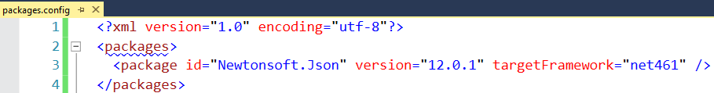
packages.config
XML file in project directory
Packages downloaded locally per-solution
Default Choice in Visual Studio
Not meant for direct editing
Init.ps1/Install.ps1/Uninstall.ps1
Legacy/Not supported for .NET Core/Standard

Slide 8
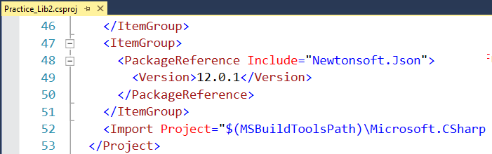
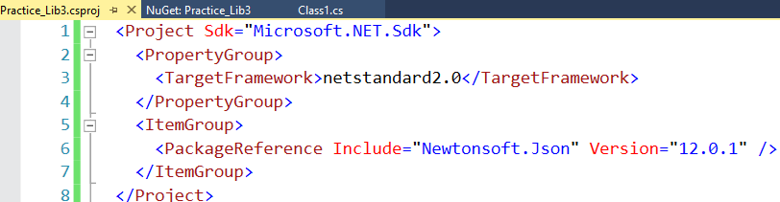
PackageReference
Stored in Project file
Packages downloaded/shared globally on local machine
`dotnet nuget locals all --list`
Only choice for .NET Core/Standard
.NET Framework Project
.NET Standard Project

Slide 9
PackageReference Breaking Changes
Adds Files Only
No install.ps1 and uninstall.ps1 script execution
Files in ‘content’ folder not automatically added to project
No workarounds available

Slide 10
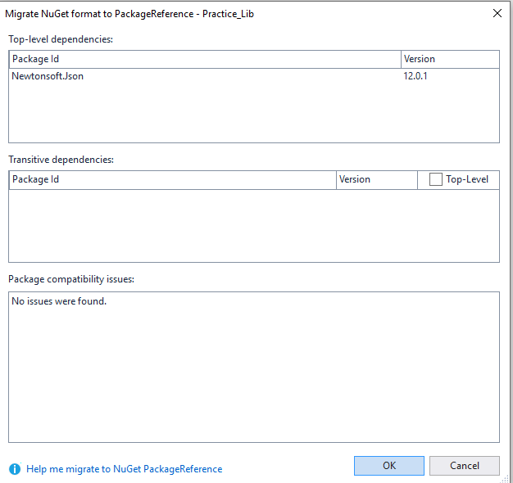
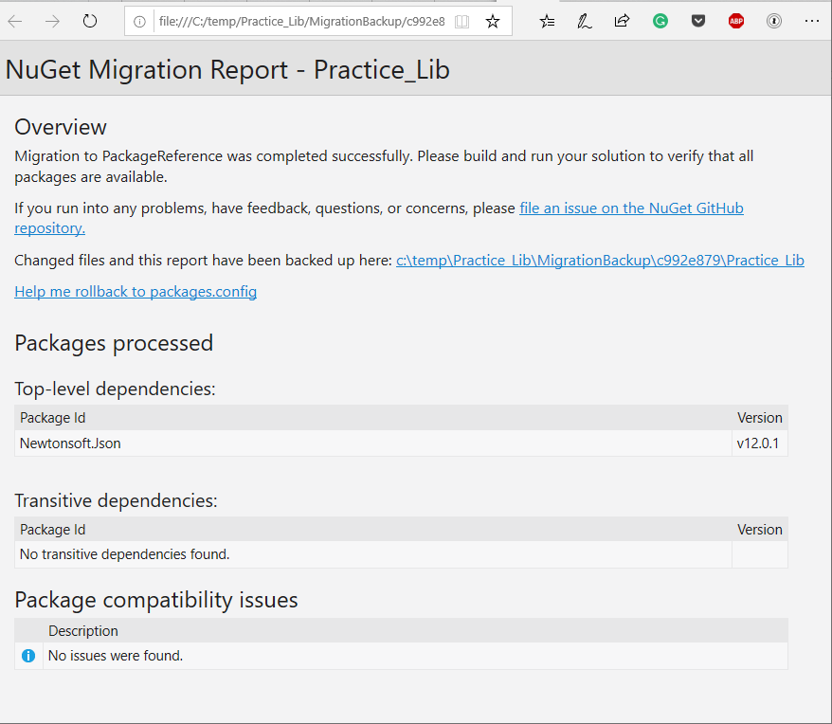
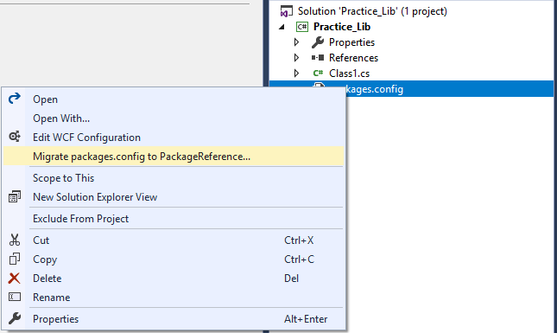
Migrating packages.config to PackageReference
Analyzer
Report
Built into Visual Studio
Analyzer runs first
HTML report after migration
Right Click Packages.config

Slide 11
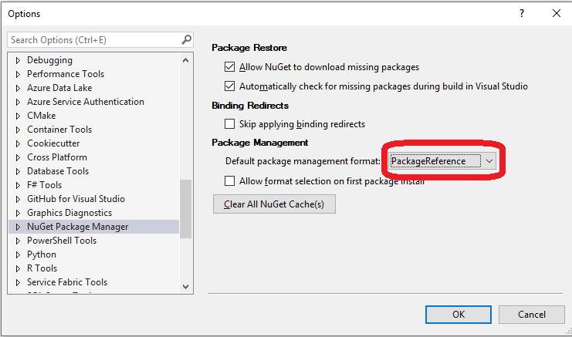
Make PackageReference the Default

Slide 12
Creating a NuGet Package: .NET Framework
In Visual Studio, Fill out info for Application (project properties)
Also info inside “Assembly Information…” button
Compile Library
Download nuget.exe
From within Project Folder, Run command: nuget spec
Generates .nuspec file
Update .nuspec file if needed
From within project folder, Run command: nuget pack

Slide 13
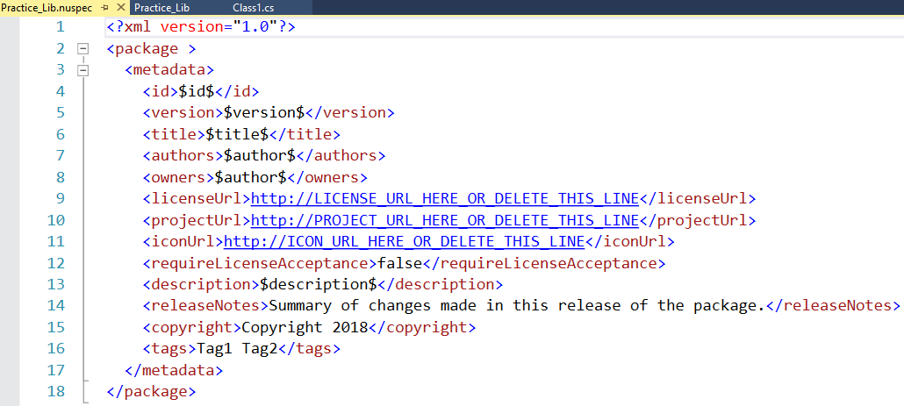
Sample .nuspec file for project
Generated with nuget.exe
Some properties taken from project data
Not all properties required

Slide 14
Creating a NuGet Package: .NET Standard
In Visual Studio, Fill out info for Package (project properties)
Right Click project -> Pack
Or ‘dotnet pack’
See package created at:
<Project>\bin\Debug\My_Lib.1.0.0.nupkg

Slide 15
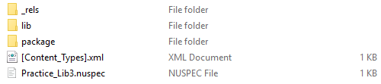
Anatomy of a NuGet Package
Files!
Package is a zip folder
Folder Structure – Not Well Documented
Lib/Content/Build/Tools

Slide 16
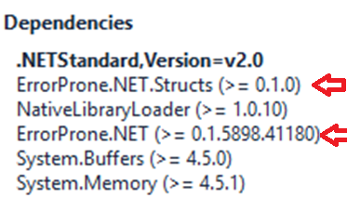
Don’t Ship Developer Dependencies
Set the PrivateAssets attribute
<PackageReference Include="ErrorProne.NET" Version="0.1.5898.41180" PrivateAssets="All" />

Slide 17

Publishing a Package
Let others consume a package to their project
Can “Push” to NuGet server
Command line, or Visual Studio (.NET Standard only)
Setup CI/CD Pipeline

Slide 18

Setting Up CI/CD Pipeline
Standard CI/CD Pipeline
Check-in Code
Compile Code
Unit Test Code
Deploy App
Test App
Promote to next environment
Repeat steps 4-5 until done
When moving environments, change config values

Slide 19
Challenges - Publishing in CI/CD Environment
Can’t change version number after file creation
Can’t change any files after file creation

Slide 20
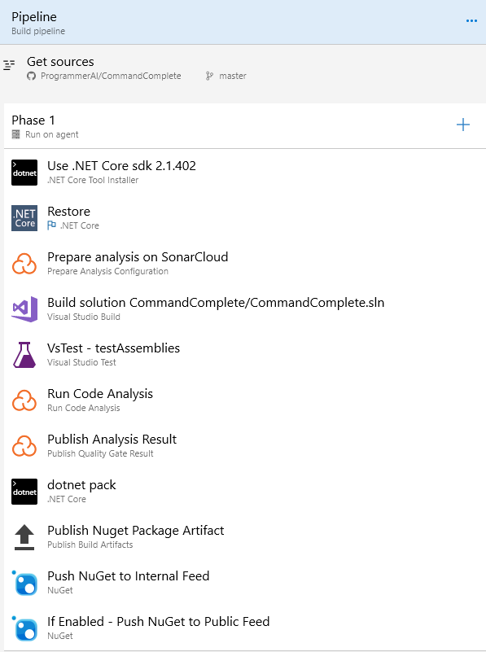
Publish Pipeline in Azure DevOps

Slide 21
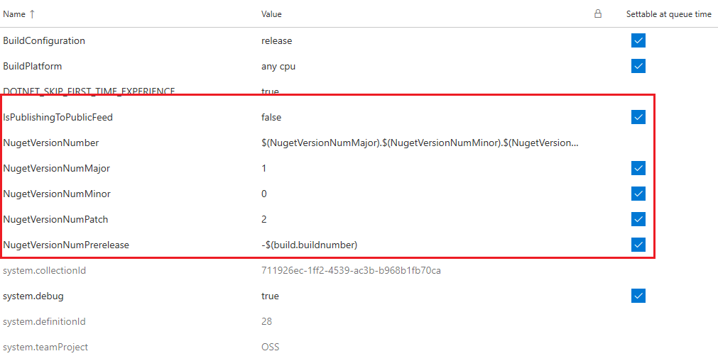
Pipeline Variables

Slide 22
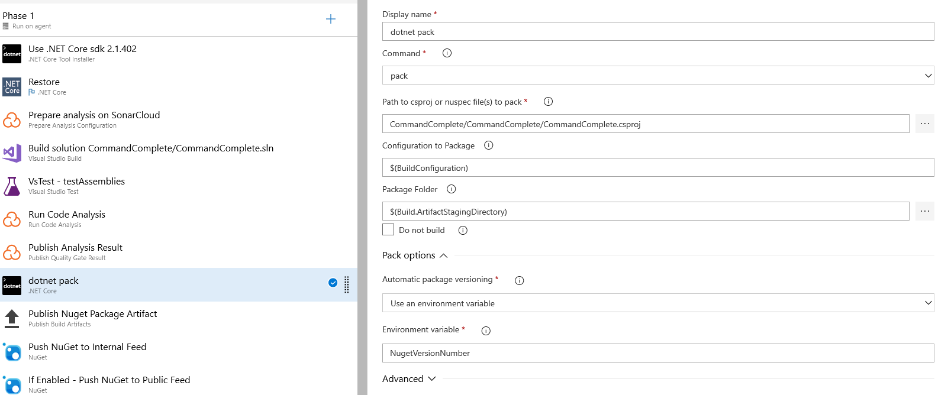
Step 8 – dotnet pack

Slide 23
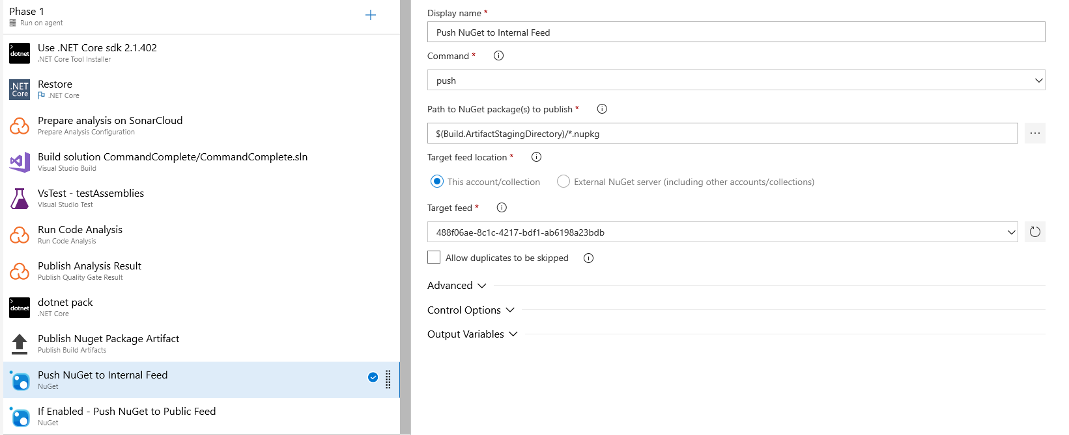
Step 10 – Push to Internal NuGet Feed

Slide 24
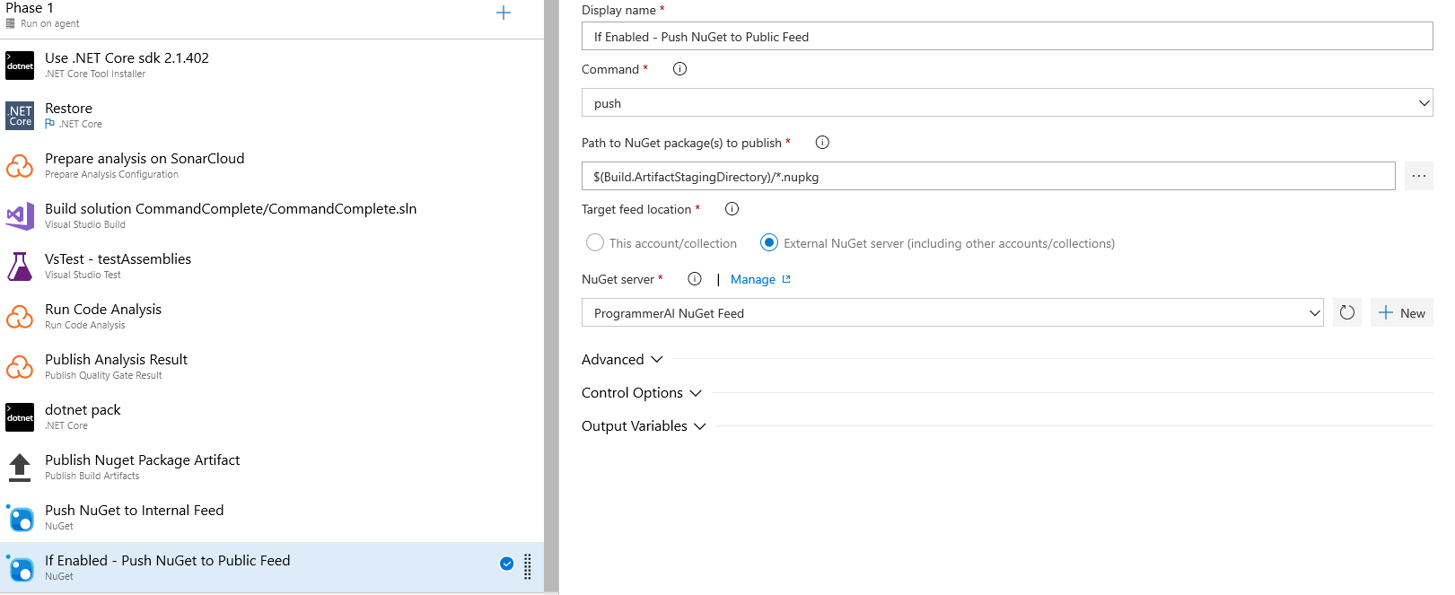
Step 11 – Push to Public NuGet Feed

Slide 25
Tangent - .NET Debugging Information
PDB Terms
Portable – .NET Core only. PDB files and separate assembly files created
Embedded – PDB info part of the assembly
Everything Else – Windows Only
Not all PDB files work everywhere
Traditionally Windows Only

Slide 26
Debugging a Package
Symbol Packages
SourceLink
Embedded Symbols
Embedded Source

Slide 27
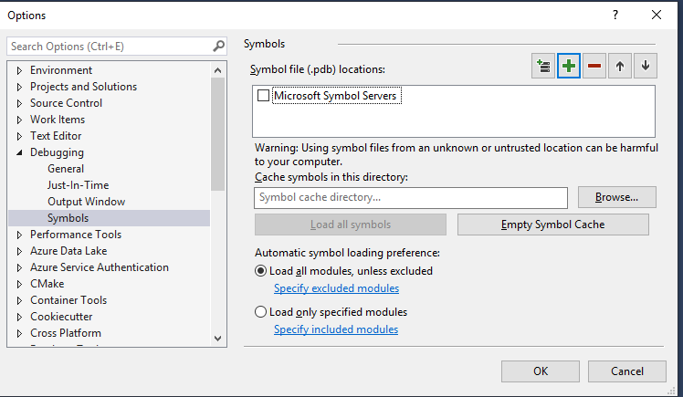
Symbol Packages
Separate *.snupkg file you also upload to NuGet server
NuGet Packages only containing PDBs for debugging

Slide 28
Symbol Packages (Legacy)
nuget pack MyProject.csproj
-Symbols
Symbol Server: https://nuget.smbsrc.net
https://docs.microsoft.com/en-us/nuget/create-packages/symbol-packages

Slide 29
Symbol Packages (Not Yet Legacy)
dotnet pack MyPackage.csproj --include-symbols -p:SymbolPackageFormat=snupkg
Symbol Server: https://symbols.nuget.org/download/symbols
NuGet.exe v4.9+ or DotNet.exe v2.2+
https://docs.microsoft.com/en-us/nuget/create-packages/symbol-packages-snupkg

Slide 30
SourceLink
Package has embedded link to source code
GitHub, Azure DevOps, TFS, GitLab
.NET Core SDK 2.1.300 or newer
Open Source Initiative
https://github.com/dotnet/sourcelink

Slide 31
SourceLink cont.
Pros
Direct link to code
Cons
Requires Internet Connection to Debug
Code/Symbols can get out of sync
Creation part of same process when creating package

Slide 32
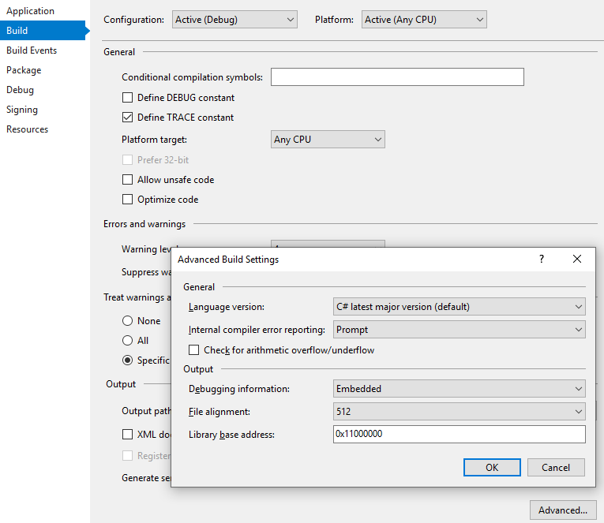
Embedded Symbols
Debug symbols are embedded in the *.dll files
NOT a NuGet thing
.NET project setting

Slide 33
Embedded Source
Pros
Doesn’t require Internet Connection
Cons:
Doesn’t Exist Yet
Greatly increases size of NuGet package
Source/Assemblies stay in sync

Slide 34
Bonus: dotPeek
JetBrains Decompiler application
Free
Decompile DLL
Generate PDB
Act as a Symbol Server

Slide 35
Misc.

Slide 36
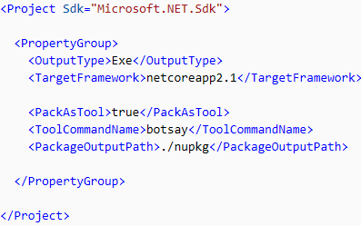
Global Tools
Only create with dotnet.exe
Command Line Applications only
‘PackAsTool’ csproj property
Community List
https://github.com/natemcmaster/dotnet-tools
INSTALL AT YOUR OWN RISK
Like every other package

Slide 37
Native Packages
C/C++ packages
Very little documentation
Consider using vcpkg instead
https://docs.microsoft.com/en-us/cpp/vcpkg?view=vs-2017

Slide 38
Signing Packages
Allows automated checks against content tampering
Requires purchasing code signing certificate
Cheapest I saw: $125/year at minimum 2 years
Can use self signed certificate for local testing purposes
Must register certificate with NuGet server
nuget sign MyPackage.nupkg -CertificateFilePath <PathToTheCertificate> -Timestamper <TimestampServiceURL>
https://docs.microsoft.com/en-us/nuget/create-packages/sign-a-package

Slide 39
Packet
Open source dependency manager
Popular with F# development
Supports referencing full packages like NuGet, or individual files hosted in a Git repo or HTTP endpoint
http://fsprojects.github.io/Paket/

Slide 40
Chocolatey
Machine-Level package manager
Built on top of NuGet
Use it to install apps on your machine like you install packages
Chrome, Python, etc
Official and community created packages of software
Free and paid licenses
https://chocolatey.org/

Slide 41
NuGet Links
NuGet.org
@NuGet on Twitter
Announcement Repo on GitHub
https://github.com/NuGet/Announcements
NuGet Blog
https://blog.nuget.org

Slide 42
Closing
Questions?
Thoughts?
Insults?

Slide 43
Shameless Plugs
@ProgrammerAL
ProgrammerAL.com
Orlando IoT Meetup

